Slide 1

Medical Insurance
Instructors: Dr. Phauk Sokkey (Course)
Mr. Nhim Malai (TD)

Slide 2
CONTENT
01
PROJECT SCOPING
02
DATA PREPARATION & EDA
03
1ST FITTING
04
2ND FITTING
05
3RD FITTING
06
CHECKING ERROR TERM
07
RESULT

Slide 3








OUR TEAM: GROUP9
NANG
Sreynich
BUTH
khemra
VANNAK
Vireakyuth
e20200447
e20201690
e20200170
SENG Panharith
LONG
Channleap
HOK
Ratanak
e20200639
e20200386
e20201106

Slide 4

PROJECT SCOPING
Medical expenses is one of the major expenses in a human life. It's a common that one life style and various physical parameters dictates diseases. According various studies, major factors that contribute to higher expenses in personal medical care include smoking, age, BMI, children, region, charges, sex.
The goal of this project, to help insurance companies to set insurance premiums that are fair and profitable. By understanding the trends in the population segments, insurance companies can better estimate the average medical care expenses for each segment. This information can then be used to set premiums that are fair to all segments and that are also profitable for the insurance company.

Slide 5

Data Preparation & EDA
Define the Categorical & Numerical Data
Statistical-Description
Data-Visualization

Slide 6

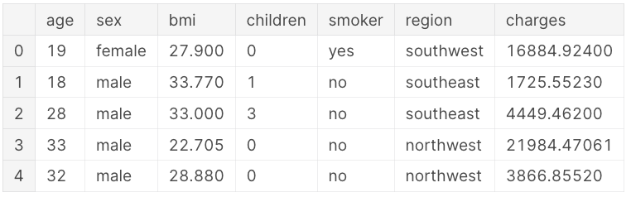
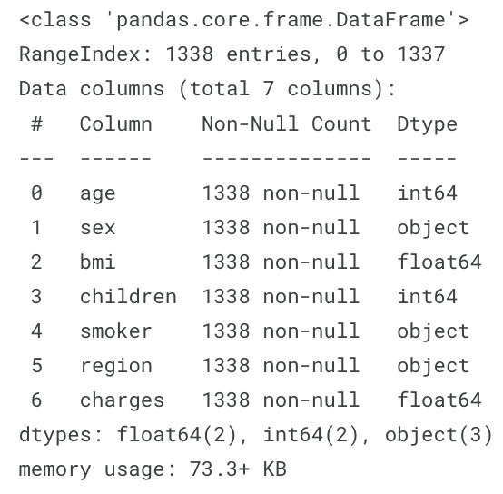
Define the Categorical and Numerical Data
Type of variable :
Categorical variables : sex, smoker, region
Quantitative variables : age, bmi, charges, children. Here children is a discrete variable where as age, bmi, and charges are continuous variables.
There are no missing values

Slide 7
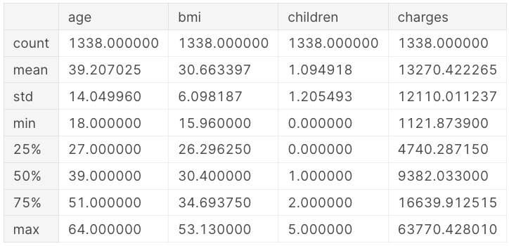
Statistical -Description of Data
Observation:
Average age of the primary beneficiary is 39.2 and maximum age is 64
Average BMI is 30.66, that is out of normal BMI range, Maximum BMI is 53.13
Average medical costs billed to health insurance is 13270 $, median is 9382 $ and maximum is 63770 $
Customer on an average has 1 child.
For Age, BMI, children , mean is almost equal to median , suggesting data is normally distributed

Slide 8
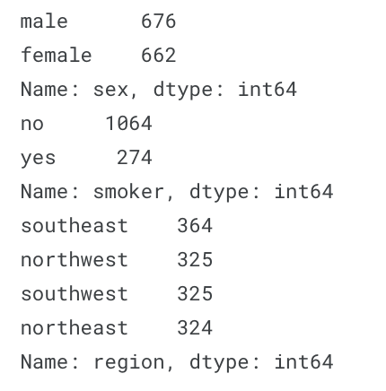
Data Preparation
Observations
676 male and 662 female, indicated sample has slightly more males than females.
1064 nonsmoker and 274 smoker, indicating sample has more nonsmokers.
Number of claims from customer who reside in southwest region is more compared to other regions

Slide 9
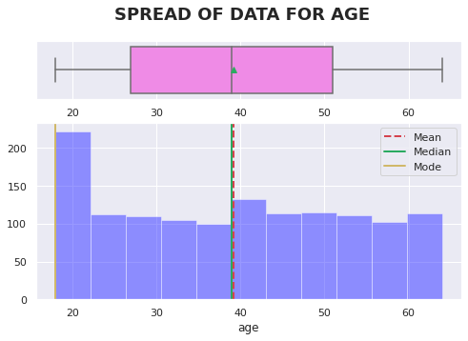
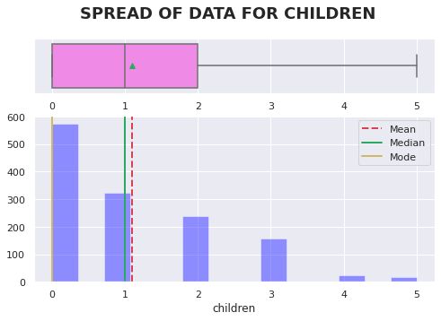
Data-Visualization
Age Distribution
The age of the primary beneficiary ranges from approximately 20 to 65 years old. The average age is about 40 years old. The majority of the customers are in their 18s and 20s.
Number of Children Distribution
Most of the beneficiaries do not have children.

Slide 10
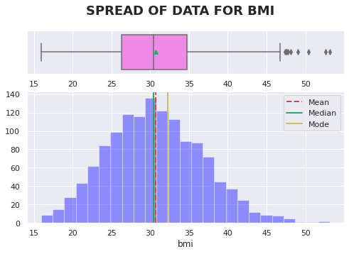
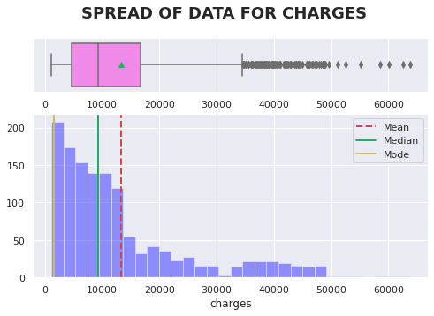
Data-Visualization Numerical
BMI Distribution
The BMIs of the beneficiaries are normally distributed, with an average BMI of 30. This BMI is outside the normal range of BMIs. There are a lot of outliers at the upper end.
Charge Distribution
The distribution of charges is unimodal and right-skewed. The average cost incurred to the insurance is approximately $130,000. The highest charge is $63,770. There are a lot of outliers at the upper end.

Slide 11
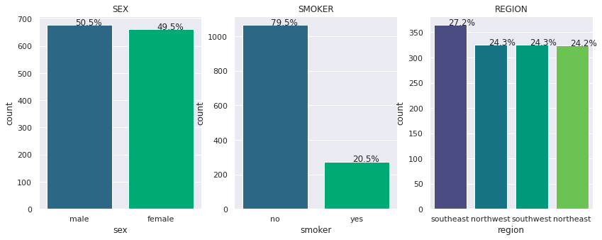
Data-Visualization Categorical
Observations
50.5% of beneficiaries are male and 49.5 % are female. Approximately same number of male and female beneficiary
20.5% of beneficiaries are smokers.
Beneficiaries are evenly distributed across regions with South East being the most populous one (~27%) with the rest of regions each containing around ~24%

Slide 12
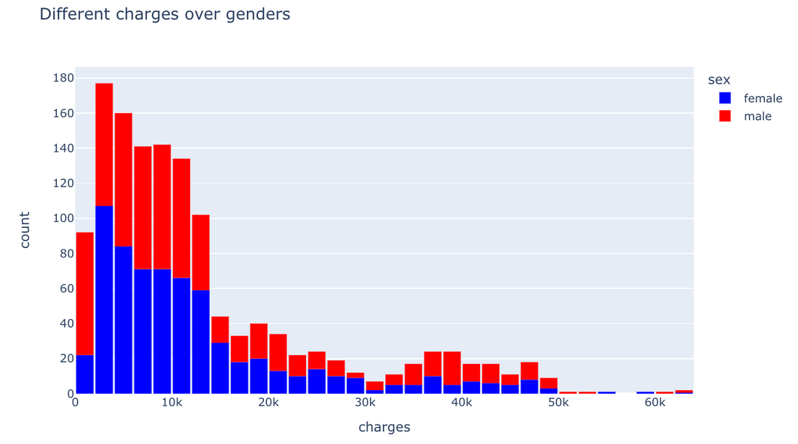
Bivariate & Multivariate Analysis
Distribution of charges over gender: Males are charged substantially more than females for health insurance.
Subconscious behavior: Males are more likely to take risks than females, which may be due to subconscious behavioral patterns.

Slide 13
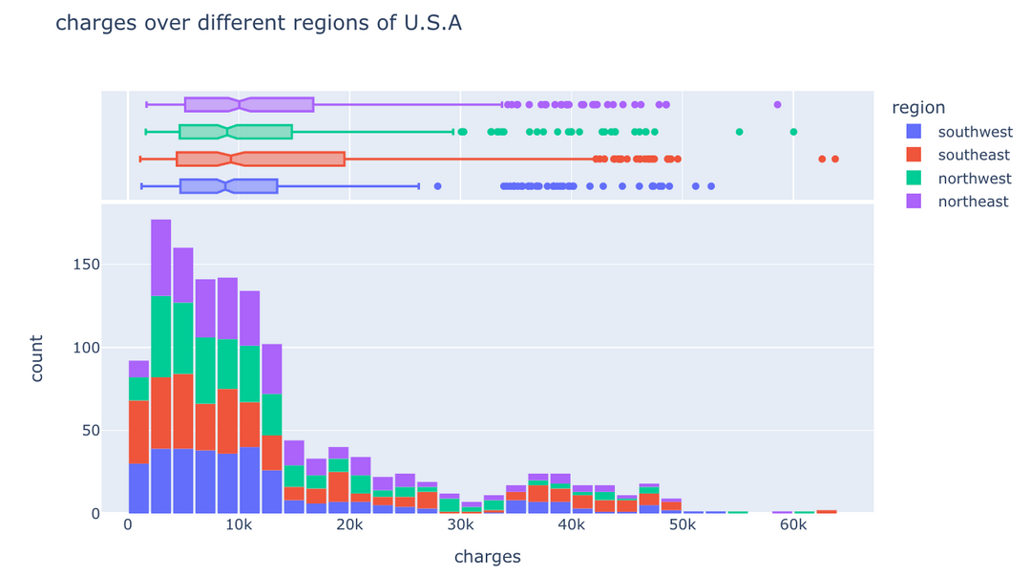
Bivariate & Multivariate Analysis
Location: The southeastern rigion has the highest average charges.

Slide 14
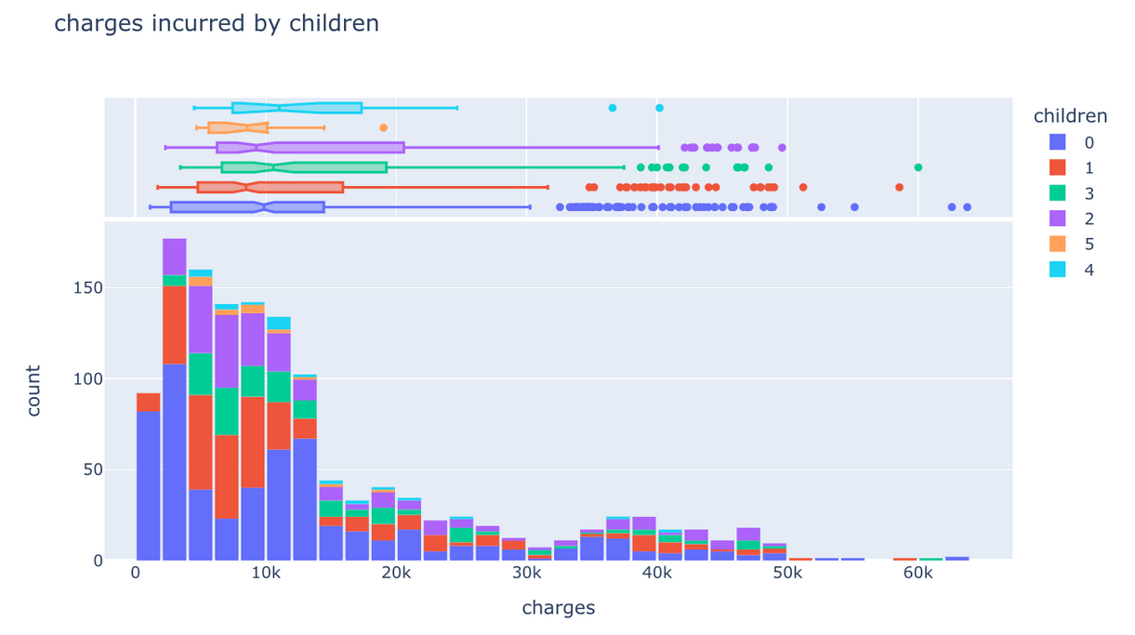
Bivariate & Multivariate Analysis
Observation:
Customers with 0 or 1 child: The majority of customers have 0 or 1 child.
Median charges: The median charges vary between 8.5k and 11k dollars. This suggests that most customers have relatively moderate medical expenses.

Slide 15
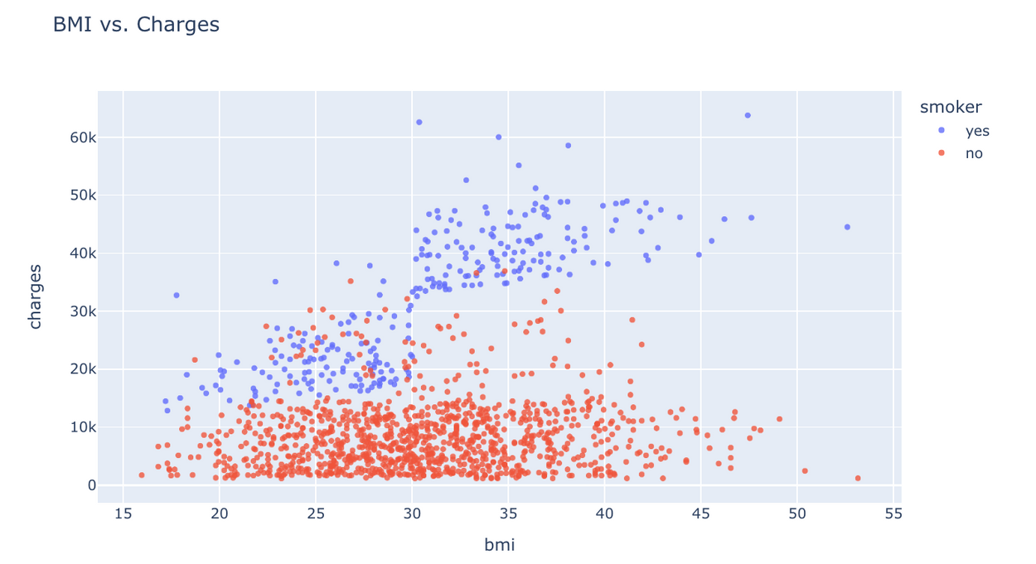
Exploratory Data Analysis
Bivariate & Multivariate Analysis
Observation:
BMI and medical charges for non-smokers: For non-smokers, there is no clear relationship between BMI and medical charges. This suggests that BMI is not a significant predictor of medical charges for non-smokers.
BMI and medical charges for smokers: For smokers, there is a clear relationship between BMI and medical charges. Smokers with a BMI greater than 30 have significantly higher medical charges than smokers with a BMI below 30.

Slide 16

Conclusion based on EDA
As expected , as the age of the beneficiary increases ,the cost to insurance increases.
Males who smoke have most claims and have higher bills.
Female who are nonsmoker also have more claims to nonsmoker males this may be because of child birth , need to explore claims type to understand better.
Customer with BMI >30 are on higher side of obesity, have more health issues and have higher claims.
Females with BMI more than 45 have billed higher to insurance.
Age, BMI and Smoking are important attributes which can cost insurance company more.

Slide 17
1st Fitting with Multiple Linear Regression
By RFR (Random Forest Regression)
Model Fitting
Result

Slide 18
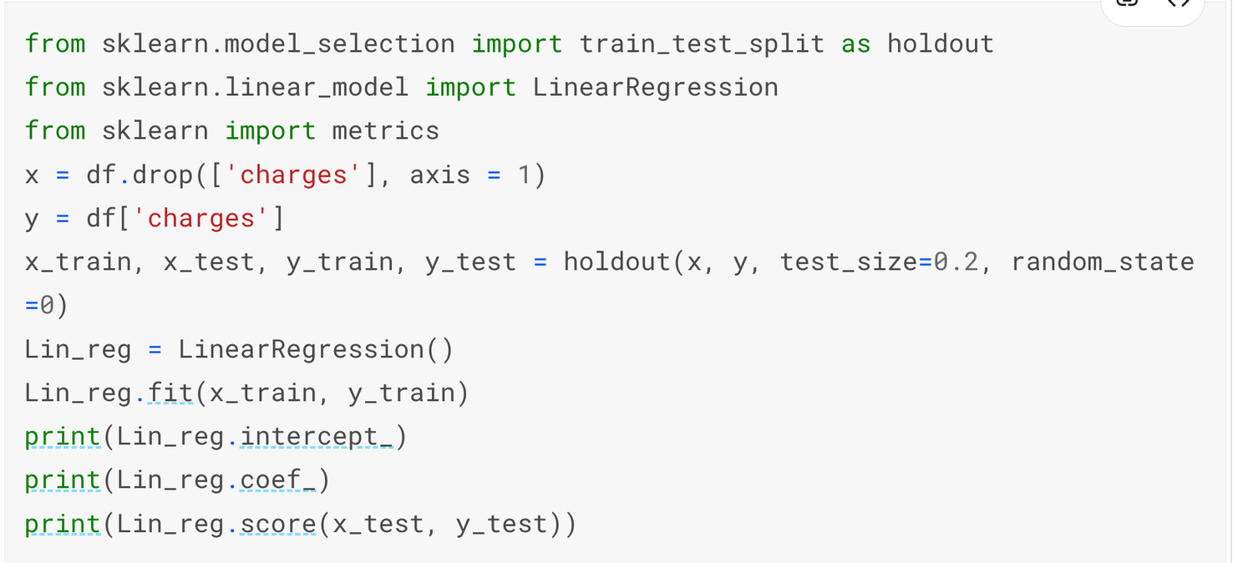
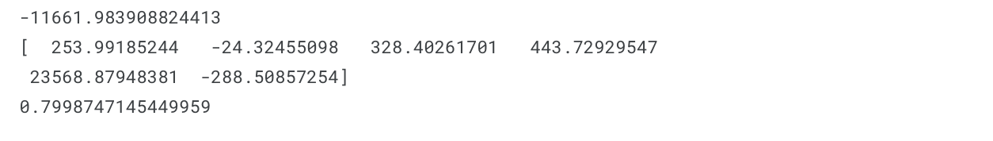
Multiple Linear Regression with 1st Method
Result:
The result we got is good enough, but we can try to improve it a bit by reducing unimportant features later.

Slide 19
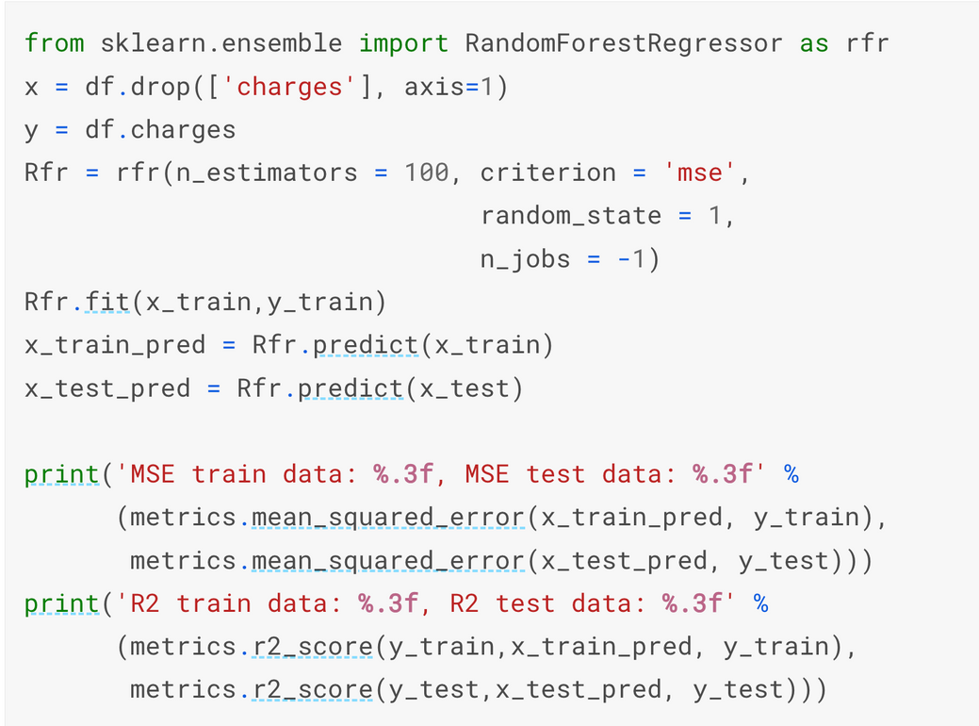
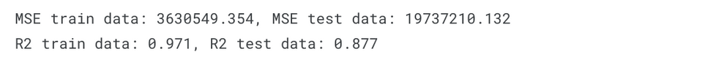
Random Forest Regression with 1 Method
Result:

Slide 20
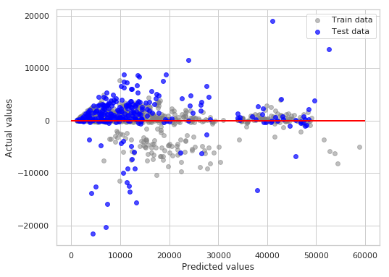
Random Forest Regression
Result:

Slide 21
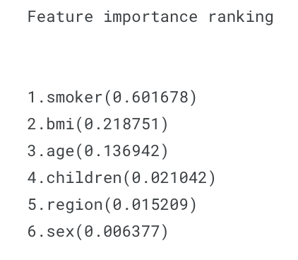
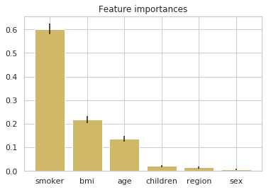
By Using RFR
1st Method

Slide 22
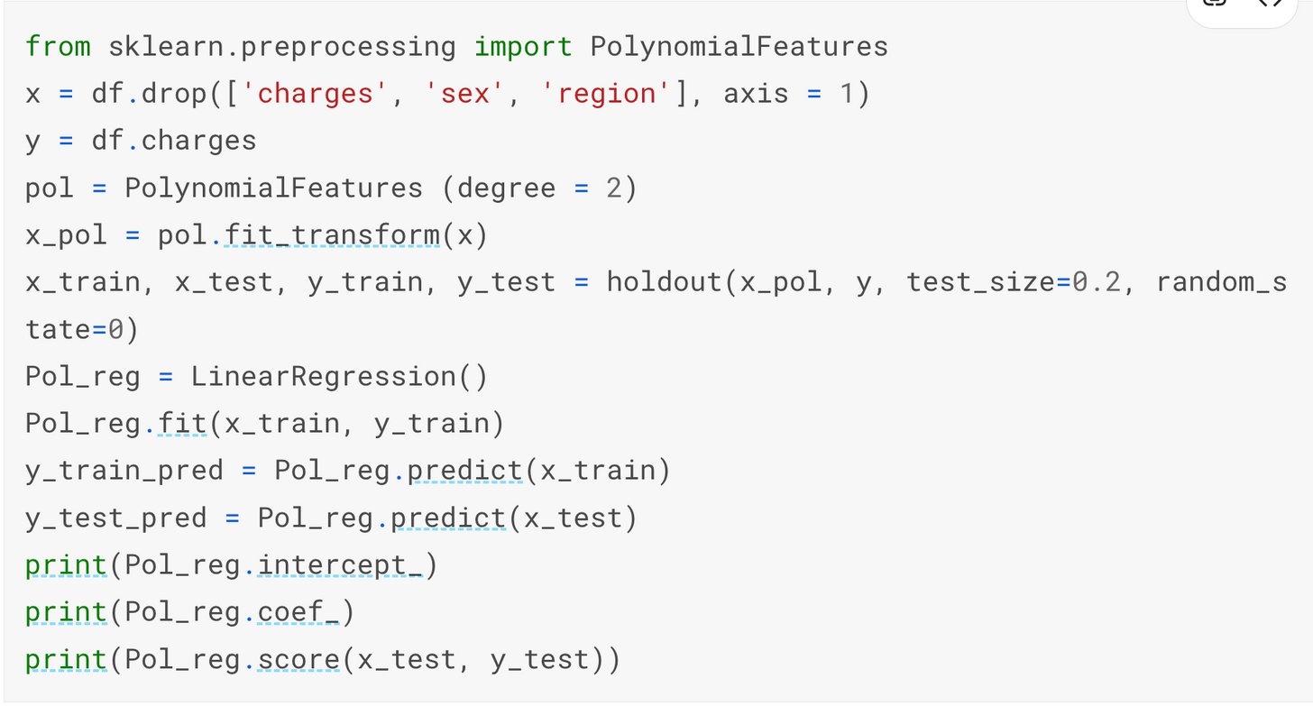

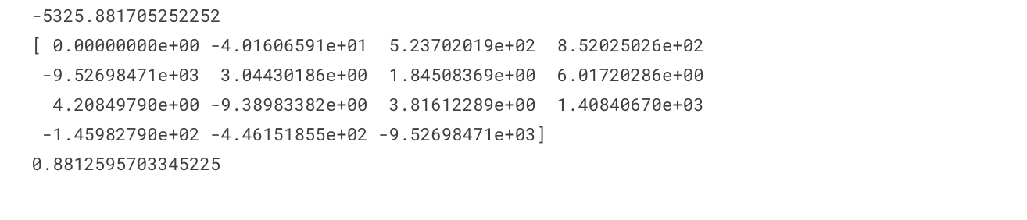
Polynomial Regression

Slide 23
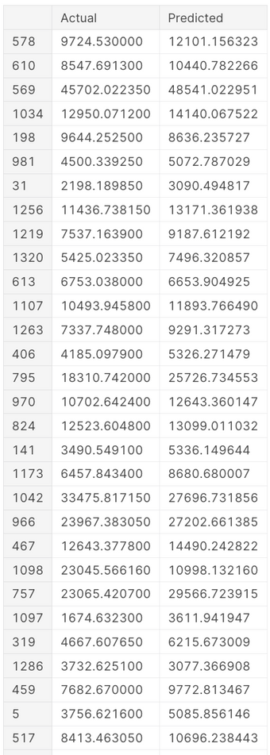
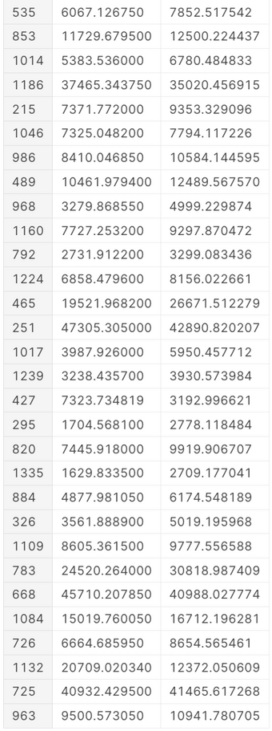
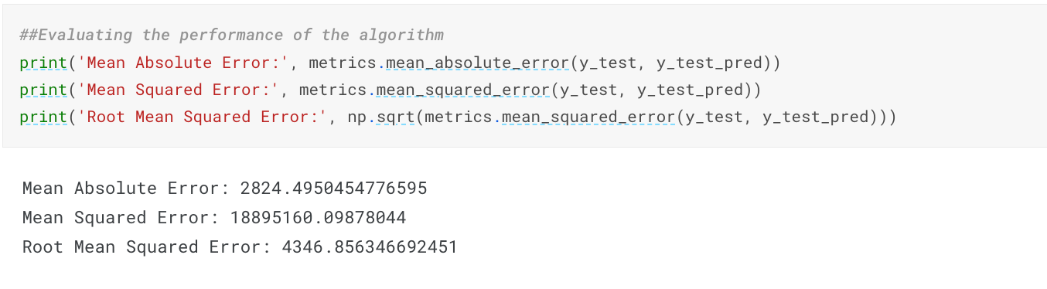
Polynomial Regression
Polynomial Regression turned out to be the best model

Slide 24
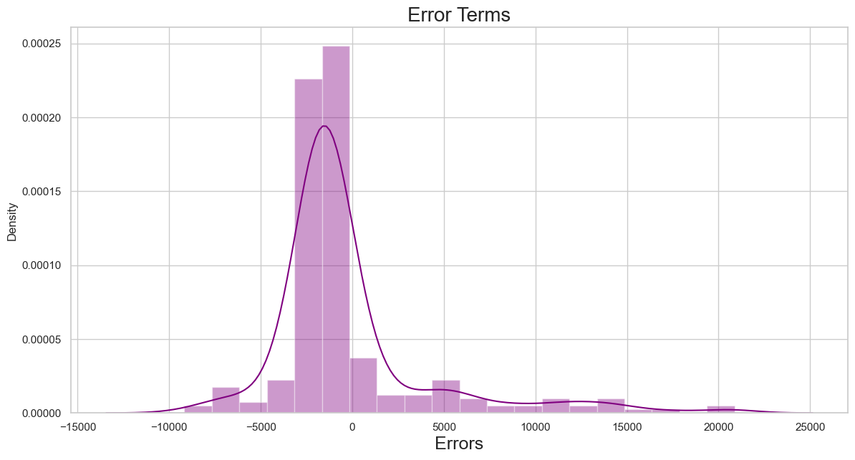
Checking the Error Term of Multiple Linear Regression
Version1 of Multiple

Slide 25
2nd Fitting with Multiple Linear Regression
By RFE (Recursive Feature Elimination)
Model Fitting
Result

Slide 26
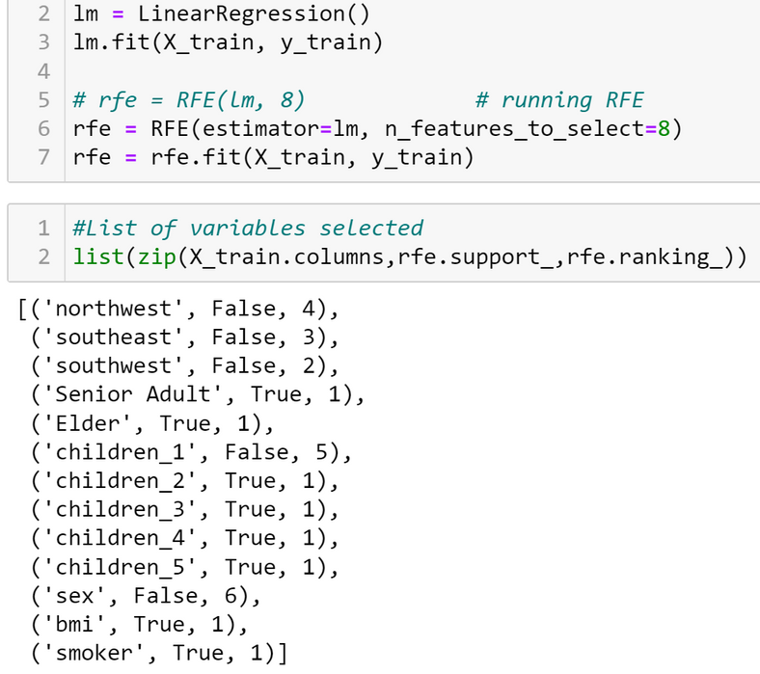
2nd Method
RFE (Recursive Feature Elimination)
Recursive Feature Elimination-RFE
By RFE, we will choose these 8 variables to fit the model such as: 'Senior Adult', 'Elder', 'children_2', 'children_3', 'children_4', 'children_5', 'bmi', 'smoker'

Slide 27
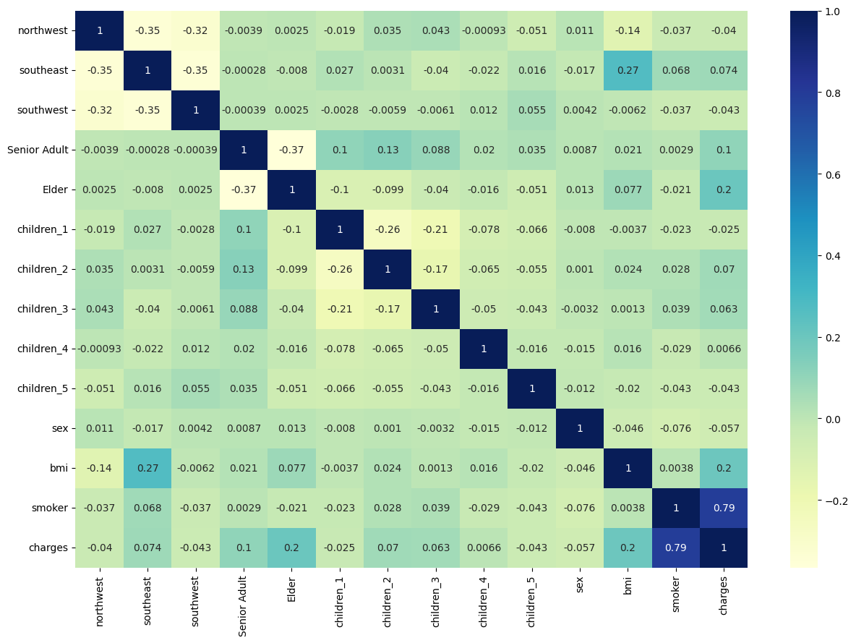

Slide 28
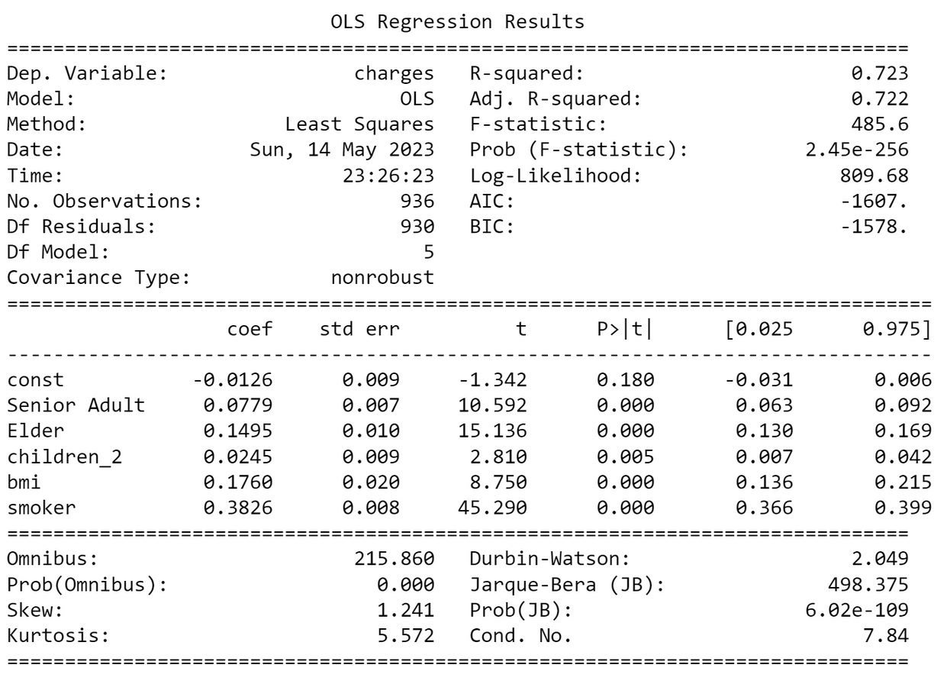
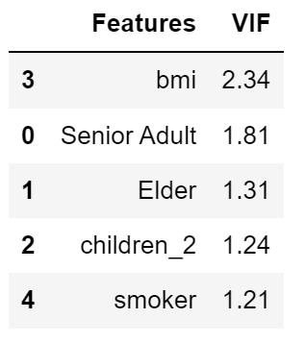
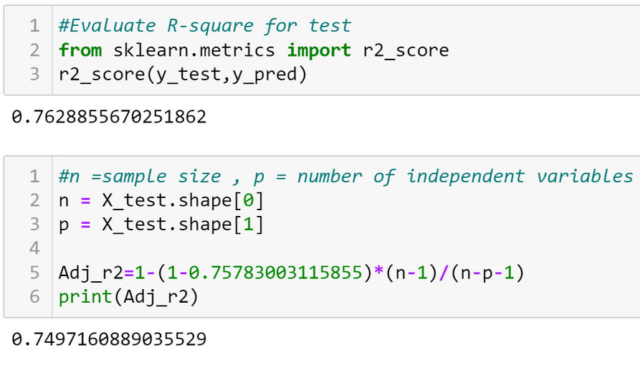
MULTIPLE LINEAR REGRESSION WITH 2ND METHOD
Now our model is good with p-values and VIF under the acceptable range

Slide 29
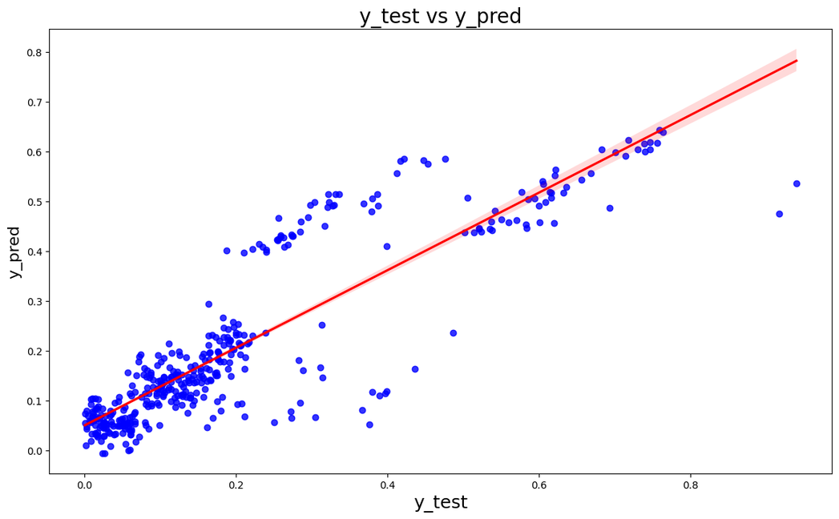
RESULT
MULTIPLE LINEAR REGRESSION WITH 2ND METHOD
From the regression analysis, we ﬁnd that region and sex do not bring signiﬁcant difference on charges.
Age, BMI, number of children and smoking are the ones that drive the charges
Smoking seems to have the most inﬂuence on the medical charges
We can see that the equation of our best fitted line is:
Charges = 0.3826 smoker + 0.077 Senior Adult + 0.149 Elder + 0.176 BMI + 0.024 Children_2

Slide 30
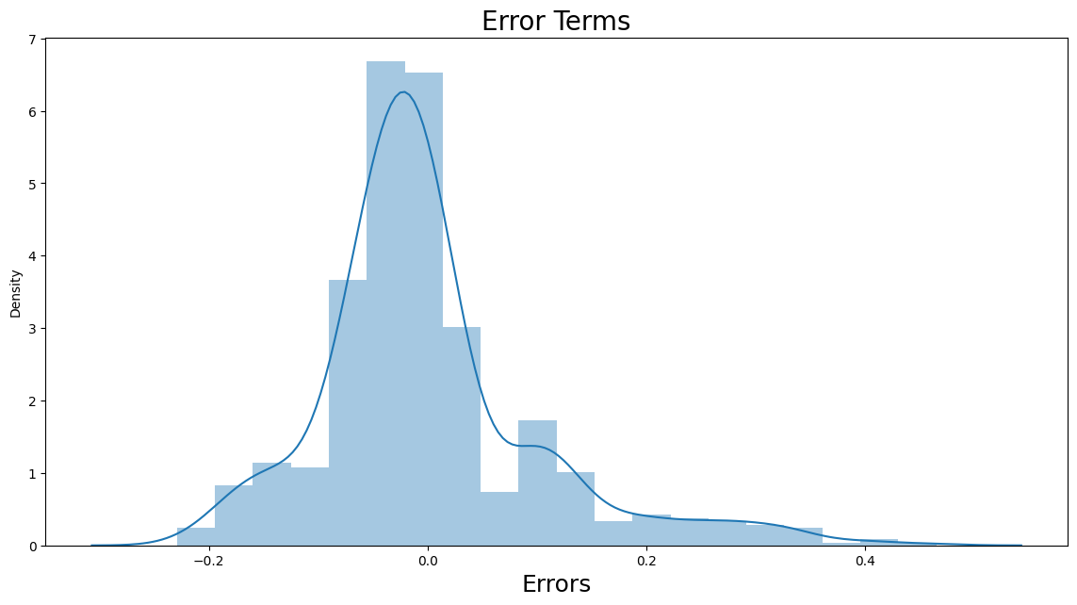
Checking the Error Term of Multiple Linear Regression
Version2 of Multiple

Slide 31
3rd Fitting with Multiple Linear Regression
By Backward & Forward Selection
Model Fitting
Result

Slide 32
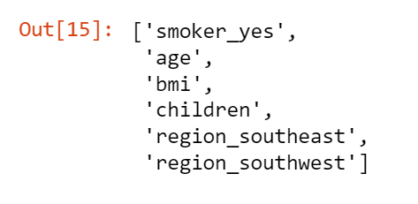
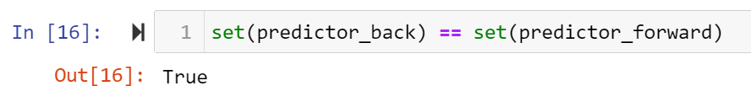
3rd Method
Backward Selection
&
Forward Selection

Slide 33
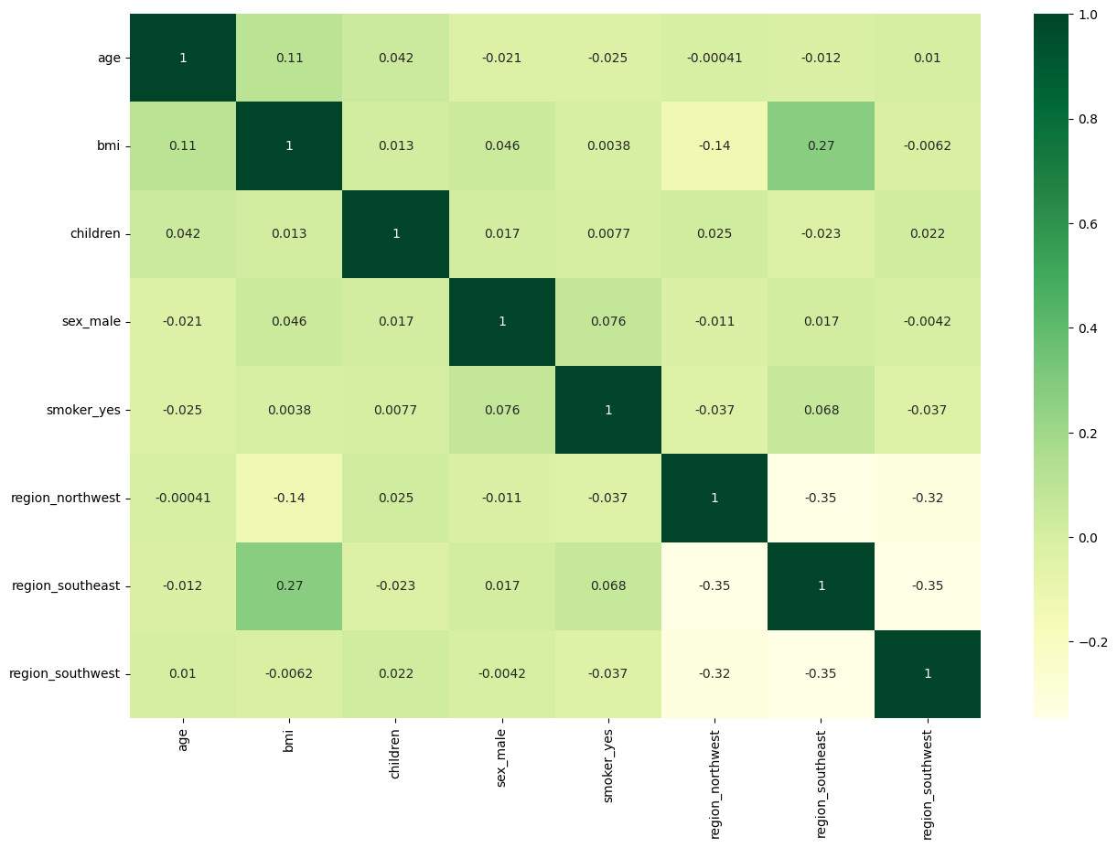

Slide 34
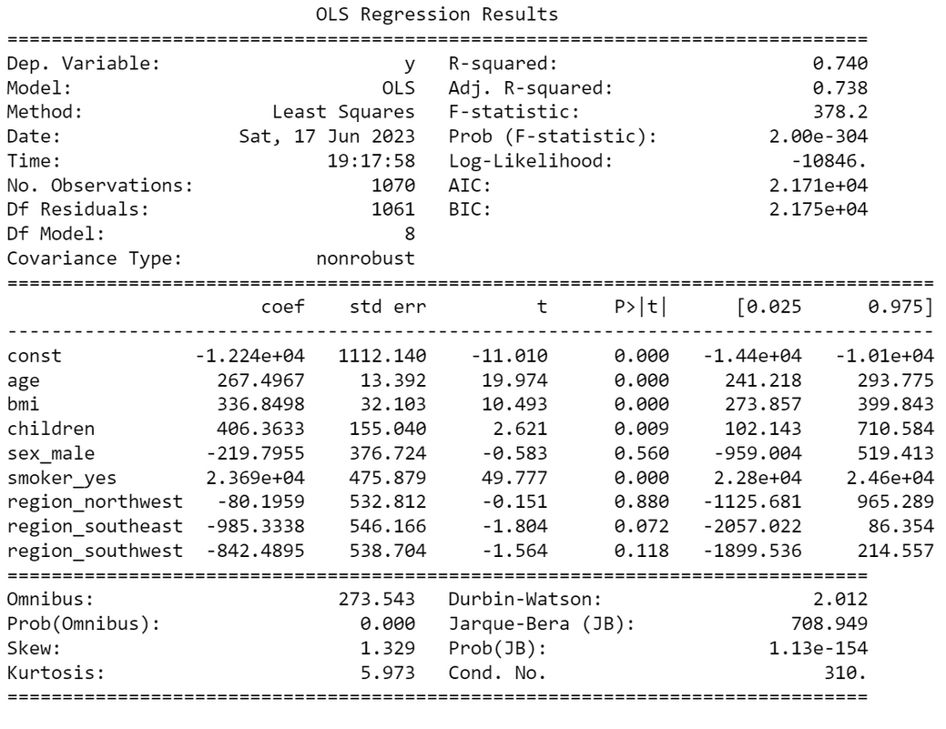
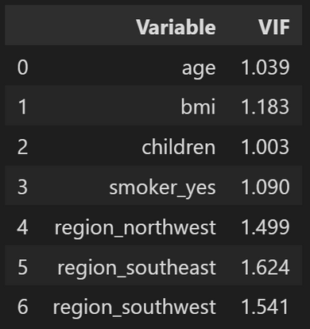
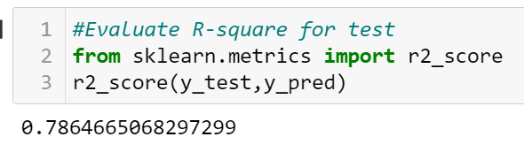
MULTIPLE LINEAR REGRESSION WITH 3RD METHOD

Slide 35
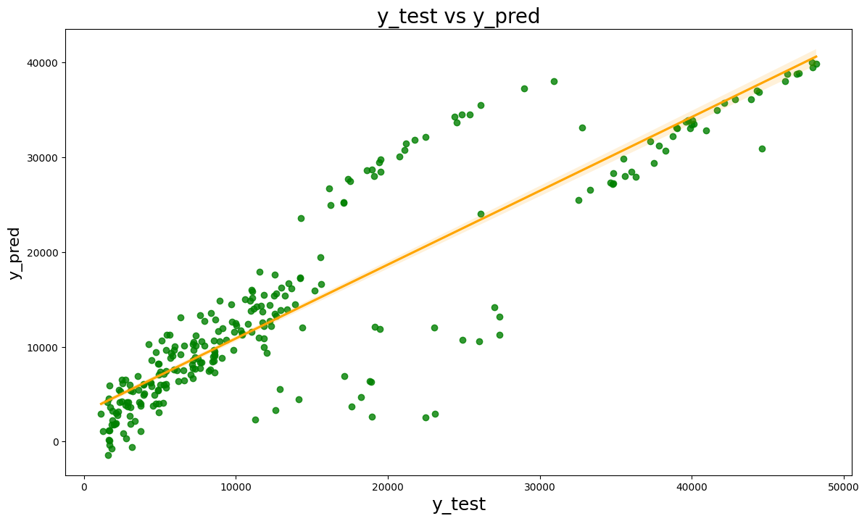
RESULT
MULTIPLE LINEAR REGRESSION WITH 3RD METHOD
From the Multiple Linear Regression model, we know that being a smoker will cause a significant increase in beneficiary's charges than those who aren't.

Slide 36
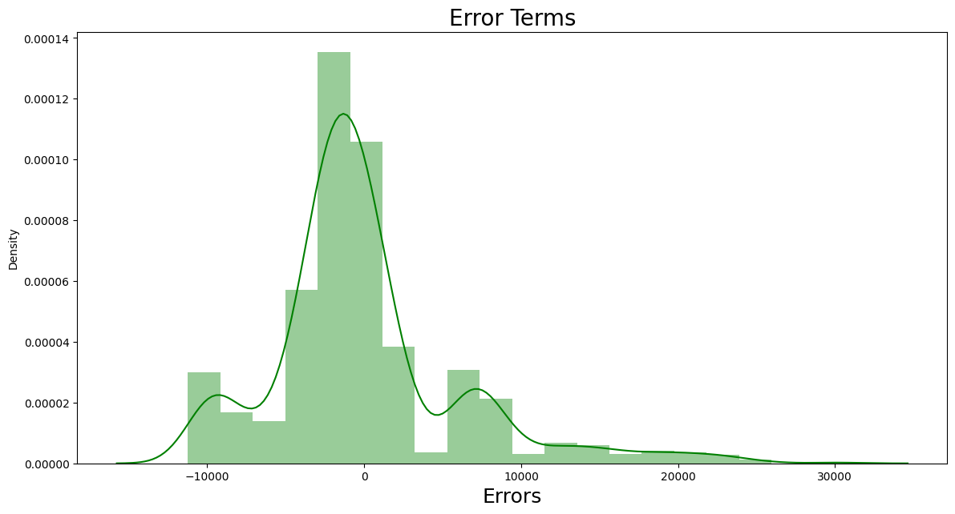
Checking the Error Term of Multiple Linear Regression
Version3 of Multiple

Slide 37
Compare the Error Term of Multiple Linear Regression
Version1 of Multiple
Version3 of Multiple
Version2 of Multiple

Slide 38

Recommendation
Based on EDA and statistical evidence it can be seen that customer who smoke or have higher BMI have more higher claims. We can encourage customers to quit smoking by providing them incentive points for talking to life coach, get help for improving lifestyle habits, Quit Tobacco- 28 day program. Give gift cards when customer accumulates specific number of points.
We can have Active wellness programs which can help up reduce claims related to BMI.
High BMI is primarily because of unhealthy life choices. We can provide customers with Diet plans and wellness health coaches which can help them to make right choices.
Provide discount coupons for Gym or fitness devices encouraging customers to exercis

Slide 39
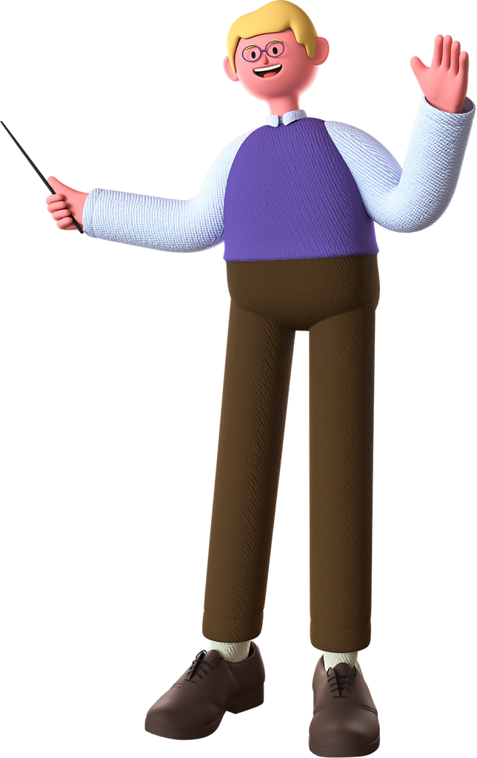
Conclusion
This project is a significant aspect of human life and are influenced by various factors such as lifestyle choices
Our project help insurance companies can have a better estimate the average medical care expenses

Slide 40
Thank you for joining us today!

